Slide 1
partners
Manuel Salmeron-Sanchez
lifETIME Executive Director
University of Glasgow

Slide 2
84 students over 5 intakes
Costs 1 student: ~£118k
£20k fees, £50k stipend, £48k RTSG
Laptop
Consumables (£24k)
Placements
Conferences
3 weeks rotation
Retreats
Training to sister universities
Students conference / industry day
Visits

Slide 3
84 students @ £118k per student – who’s funding them?
40 EPSRC
12 HEI (5 Glasgow, 4 B’ham, 3 Aston)
5 clinical fellows (NHS & partners)
2 partners
25 SFI

Slide 4
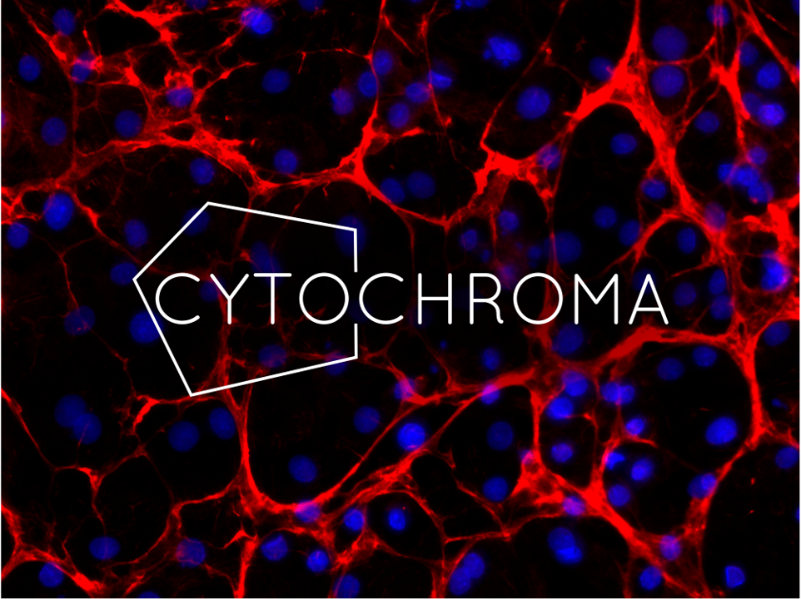
23 Partners

Slide 5
23 Partners
AFR-UK
Atelerix
BASF
BiogelX
Cell and Gene Therapy Catapult
Cell Guidance Systems
Cyclacel
Cytochroma
Cytonome
DSTL
Sir Bobby Charlton Foundation
Golden Jubilee National Hospital
InSphero
LGC
Nissan
OxSyBio
QuantuMDx Group Ltd
ReNeuron
Reprocell
Sphere Fluidics
Spheritech
Terumo Aortic
Tiajing Modern
shape the future of the CDT
co - create projects
co – supervise students
in cash & in kind support

Slide 6
iClub –
Adumatech
AstraZeneca
Bone Cancer Research Trust (BCRT)
Biolamina
Celentyx
Charles River Laboratories
CPI
The Electrospinning Company
Entrepreneur Business School (EBS)
Evotec/Cyprotex
Glasgow Royal Infirmary
MHRA
MRC ARUK Centre for musculoskeletal ageing
N8 Research Partnership
NC3Rs
NHS Research Scotland (NRS-CMT)
NIHR Surgical Reconstruction and Microbiology Research Centre
Georgia Institute of Technology
Queen Elizabeth University Hospital
Hospital La Fe
Scottish Health Innovation Ltd (SHIL)
Scottish National Blood Transfusion Service
The Royal Orthopaedic Hospital
The Scar Free Foundation Birmingham Burns Research Centre
UKRMP Smart Materials Hub
UofG College of Science & Engineering
in kind support

Slide 7
Partners - our crowdfunding model
Contribute with fixed amount to the CDT
Co-create projects with academics
Co-supervise students
When? 5 intakes 2019 – 20 – 21 – 22 – 23 – 24
How many? 23 partners & 84 studentships

Slide 8
Partners - our crowdfunding model
We are financially stable:
We do not really need more partners
We need partners to fulfill their commitment (!)
BUT

Slide 9
Partners - our crowdfunding model
Letter sent to partners (November)
We have your letter of support for the application
We need signature of partners letter to confirm commitment
You can set terms how you pay us !

Slide 10
Partners - our crowdfunding model

Slide 11
Partners - IP
Following the recruitment of a student the IP for a project will be agreed between the University, Company and Student.
This will be in the format of a standard studentship agreement.
The university that the project belongs to will be responsible for creation of the studentship agreement.

